Slide 1
2016 PERFORMANCE-BASED BONUS GUIDELINES

Slide 2
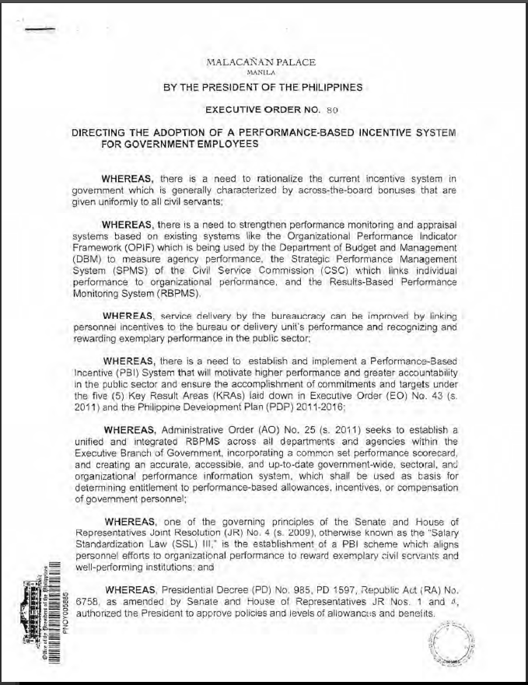
What is PBB?
“The PBB, which is a top-up bonus, shall be given to personnel of bureaus or delivery units in accordance to their contribution to the accomplishment of their Department’s overall targets and commitments…”
-EO 80 (s.2012)

Slide 3
Agency and Individual Eligibility
(MC 2016-1)
Ranking of Delivery Units and Individuals
(DO 53, s.2017)
Objectives of PBB
Rationalize the incentive system in government which was previously characterized by across-the-board bonuses that are given uniformly to civil servants.
Strengthen the performance monitoring and appraisal systems based on existing systems like the OPIF, SPMS, and RBPMS.
Improve service delivery by linking personnel incentives to the bureau or delivery unit’s performance and recognizing and rewarding exemplary performance.
Motivate higher performance and greater accountability, and ensure the accomplishment of commitments and targets.
Notes:
Objectives:
Rationalize the incentive system in government which was previously characterized by across-the-board bonuses that are given uniformly to civil servants.
Strengthen the performance monitoring and appraisal systems based on existing systems like the Organizational Performance Indicator Framework (OPIF) which is being used by the DBM to measure performance, the Strategic Performance Management System (SPMS) of the CSC which links individual performance to organizational performance, and the Results-Based Performance Monitoring System (RBPMS).
Improve service delivery by linking personnel incentives to the bureau or delivery unit’s performance and recognizing and rewarding exemplary performance in the public sector.
Motivate higher performance and greater accountability in the public sector, and ensure the accomplishment of commitments and targets under the 5 Key Result Areas (KRAs) laid down in EO 43 (s. 2011) and the PDP 2011-2016.

Slide 4
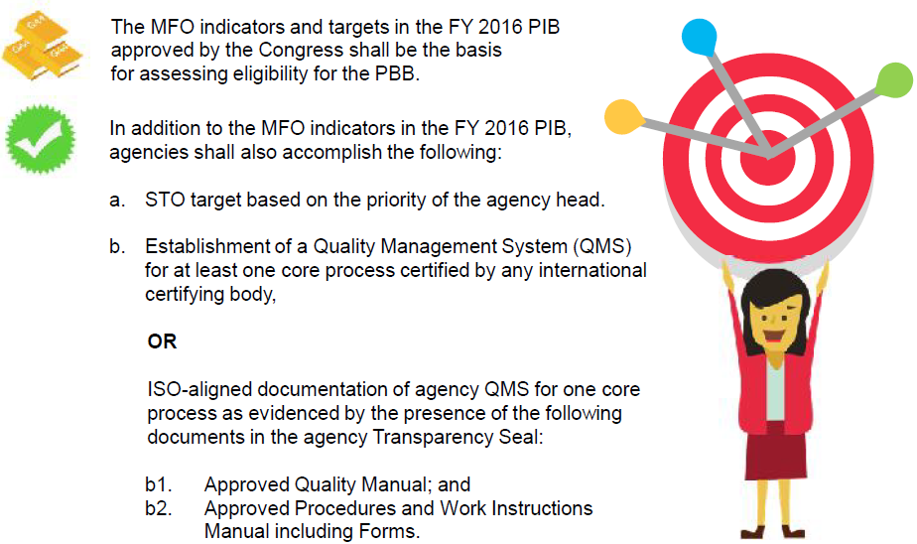
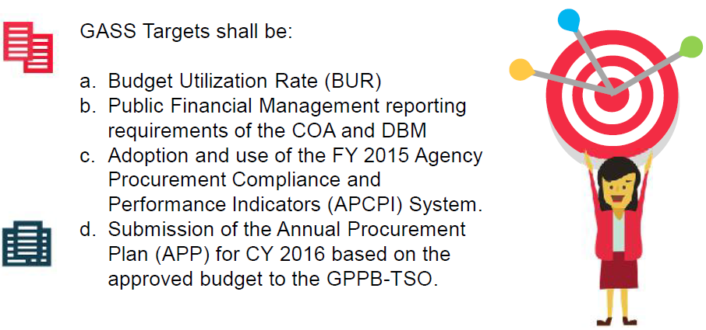
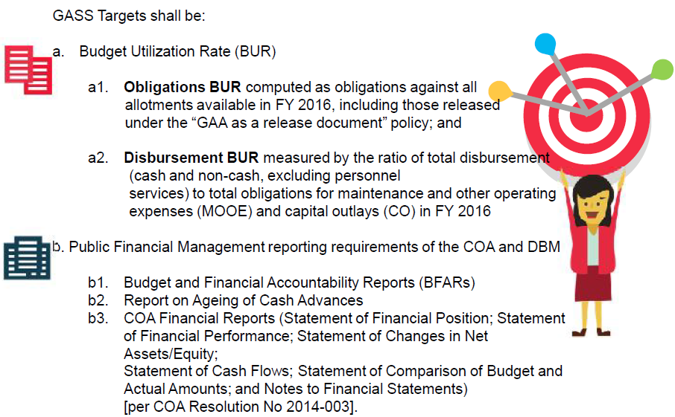
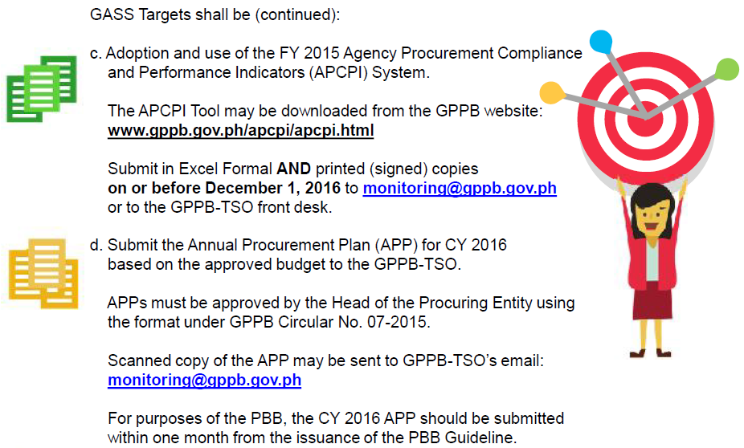
Agency Eligibility
Achieve performance targets in the delivery of MFOs, STO and GASS.
Satisfy 100% of the Good Governance Conditions
Use the applicable performance rating systems – RPMS and CESPES

Slide 5
Take note!
Inability to meet any of the pre-conditions shall render ineligibility for the grant of PBB
In cases wherein a specific delivery unit is deemed non-compliant for any of the above conditions, the PMT where the non-compliance exists shall meet to determine the highest accountable official, and all staff members responsible for the non-compliance. The highest accountable official must be a Section Chief, Unit Head, or higher. The said personnel will be included in the isolation list for the FY 2016 PBB, and will be ineligible for the grant of PBB for FY 2016.

Slide 6
Where are we now in terms of Agency Eligibility?
PBB Requirement | Status
Agency Accomplishments vis-à-vis MFO, STO, GAS Targets | Need to submit justification on underachievement and non-availability of data in some MFO indicators
Good Governance Conditions
Transparency Seal | Compliant
PhilGEPS | 25 non-compliant delivery units *highest ranking official and concerned personnel will be isolated
Citizen’s Charter | Compliant
Public Financial Management Report
BFARs | On-going review
Report on Ageing of Cash Advances | Compliant
COA Financial Reports | Compliant
Operations Manual / QMS | Compliant

Slide 7
Individual Eligibility
Who will receive the PBB?

Slide 8
Who will receive the PBB?
All officials and employees holding regular plantilla, and contractual and casual personnel, having an employer-employee relationship
Salaries are charged to the lump sum appropriation under PS, or occupying positions in the DBM-approved contractual staffing pattern
First and Second level employees and officials performing managerial and executive functions, who are neither Presidential appointee nor covered by CESPES, who receive an at least “Satisfactory” rating under RPMS
Third level officials and all incumbents of CES positions who receive an at least “Satisfactory” rating under CESPES

Slide 9
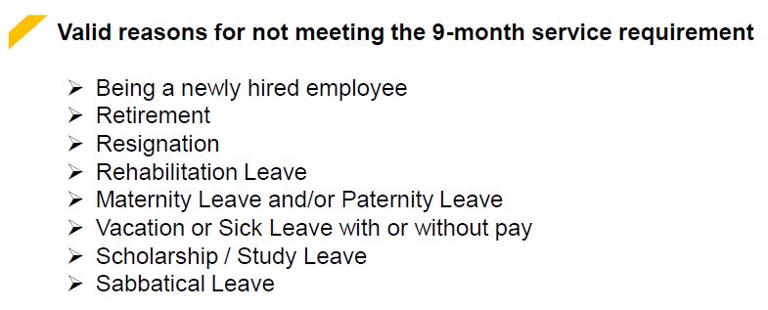
Who will receive the PBB?
An official or employee who has rendered a minimum of 9 months of service in the current rating period, and with at least “Satisfactory” performance rating may be eligible to the full grant of the PBB.
An official or employee who rendered less than nine (9) months but a minimum of three (3) months of service in the current rating period, and with at least “Satisfactory” performance rating may be eligible for the grant of PBB on a pro-rata basis corresponding the actual length of service rendered:
Length of Service | % of PBB Rate
8 months but less than 9 months | 90%
7 months but less than 8 months | 80%
6 months but less than 7 months | 70%
5 months but less than 6 months | 60%
4 months but less than 5 months | 50%
3 months but less than 4 months | 40%

Slide 10
Who will receive the PBB?
Personnel on detail to another government agency for six (6) months or more shall be included in the ranking of employees in the recipient agency that rated his/her performance. Payment of PBB shall come from the parent agency.
Personnel who transferred from one government agency to another shall be rated and ranked by the agency where he/she served the longest. If equal months were served for each agency, he/she shall be included in the recipient agency.
The same shall apply to personnel on detail, reassigned, and transferred to other delivery units within DepEd, except that the payment of PBB shall come from the delivery unit where he/she is rated and ranked.

Slide 11
Who will NOT receive the PBB?
Consultants, experts, and/or technical assistants who are hired under Contract of Service or job order in the absence of an employer-employee relationship
Employee on vacation leave, with or without pay, for the entire rating period
Personnel found guilty of administrative and/or criminal cases and meted penalty in 2016, EXCEPT if the penalty meted is only a reprimand
Officials and employees who failed to submit 2015 SALN
Officials and employees who failed to liquidate Cash Advances received in 2016 within the reglementary period

Slide 12
New features of 2016 PBB
PBB rates of individuals shall depend on the performance ranking of the delivery unit where they belong, as a percentage of their monthly basic salary
Third level officials should receive at least “Satisfactory” rating under CESPES

Slide 13
Ranking of Delivery Units and PBB Rates
RANKING | PERFORMANCE CATEGORY | INDIVIDUAL PBB RATES AS % OF MONTHLY BASIC SALARY
Top 10% | BEST | 65%
Next 25% | BETTER | 57.5%
Next 65% | GOOD | 50%
*or Php5,000, whichever is higher

Slide 14
What are the Delivery Units?
CO
RO
SDO
OSEC, bureaus and services, and NEAP
17 ROs
*including NIR
*excluding ARMM
All SDOs of the 17 regions
All public elementary, JHS and SHS

Slide 15
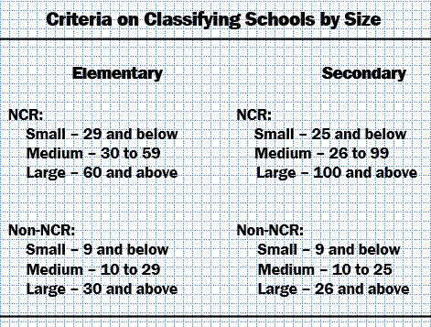
School Level Ranking
Covers all public elementary, JHS and SHS
school ID registered in EBEIS
completed at least 1 rating period by end-SY2015-16
*Annex and extension schools that do not have school ID at the start of SY will be included in mother school
Schools will be ranked at the regional level
Separate ranking for Elementary and Secondary schools
* Secondary include JHS and SHS
Separate ranking for LARGE, MEDIUM, and SMALL schools
RSHS will be ranked nationally
RO
LARGE
MEDIUM
SMALL
BEST
BETTER
GOOD

Slide 16
School Level Ranking
2015
2016
Performance Indicators | Maximum Points
OPCRF overall score | 50
% of learners who scored average and better in LAPG, NAT or its equivalent in SY 2014-15 | 20
Simple Dropout Rate in SY 2014-15 | 20
% of liquidation of school MOOE from January 1 to December 31, 2015 and timeliness of monthly submission as of the 5th working day of the succeeding month. | 10
Plus factor | 1
Performance Indicators | Maximum Points
OPCRF overall score (SY 2016-2017) | 80
% liquidation of school MOOE* in FY 2016 and timeliness of monthly submission as of the 5th working day of the succeeding month | 20
Plus factor: If Brigada Eskwela Awardee in the national level (DM 23, s.2017) If recipient of national awards | 1
Notes:
Schools with no MOOE allocation due to failure to liquidate MOOE in the previous year shall be given 0 points
Newly-established schools with no MOOE allocation shall use the liquidation data of LGU funds as certified by the LGU
School annexes and extensions with school ID but whose MOOE still attached to the mother school shall use the MOOE liquidation of the mother school
IUs shall use the budget utilization rate and timeliness of submission of BFARs in accordance with the required deadlines by the DBM.

Slide 17
What if there is a tie?
The schools with the same total scores shall be ranked based on the improvement from previous year’s performance in OPCRF overall score and % liquidation of school MOOE, in that order.
If after the above cited criteria have been considered and there is still a tie, all schools with equal total scores will be moved to the next performance category.

Slide 18
Division Level Ranking
Covers all SDOs of the 17 regions:
completed at least 1 rating period as of end-2016
included in the 2016 GAA
*SDOs that do not satisfy the above parameters will be included in the mother division
SDOs will be ranked at the regional level
No classification based on size will be applied
RO
BEST
SDO
SDO
SDO
BETTER
SDO
SDO
SDO
GOOD
SDO
SDO
SDO

Slide 19
Division Level Ranking
2015
2016
Performance Indicators | Maximum Points
Performance Indicators | Maximum Points
OPCRF overall score (FY 2016) | 80
Average OPCRF ratings of schools within the SDO | 5
FY 2016 BUR (based on obligations as of December 31, 2016) | 10
% of liquidation of Cash Advances received in FY 2016 | 5
OPCRF overall score | 50
% of 5 year old children enrolled in Kindergarten in SY 2014-15, both Public and Private | 5
% of 6-11 year old pupils enrolled in Elementary in SY 2014-15, both Public and Private | 5
% of 12-15 year old students enrolled in Secondary in SY 2014-15, both Public and Private | 5
% of elementary schools, both Public and Private, with improvements in the % of learners who scored average and better in NAT or its equivalent in SY 2014-15 | 5
% of secondary schools, both Public and Private, with improvements in the % of learners who scored average and better in NAT or its equivalent in SY 2014-15 | 5
Simple dropout rate in SY 2014-15, both Public and Private | 5
% of school MOOE downloaded three (3) working days upon receipt of liquidation reports of schools | 5
% of FY 2015 newly created teaching and non-teaching items with NOSCA filled up within 3 months | 5
% of excess teachers re-deployed in SY 2014-15, including those hired by the Local School Board (LSB) | 2.5
% of private schools submitting EBEIS data on or before August 28, 2015 | 2.5
% of applications for permit to operate/ recognition processed and endorsed to the RO within the prescribed number of days of processing vis-à-vis the total number of private school applicants with complete documentary requirements in FY 2015 | 2.5
% of A&E passers over enrollees in FY 2015 | 2.5
Plus factor: | 1

Slide 20
Regional Level Ranking
CO
Covers 17 regions, including NIR, but excluding ARMM
ROs will be ranked at the national level
No classification based on size will be applied
BEST
RO
RO
RO
BETTER
RO
RO
RO
GOOD
RO
RO
RO

Slide 21
Regional Level Ranking
2015
2016
Performance Indicators | Maximum Points
OPCRF overall score | 50
% of SDOs within the region categorized as Best and Better | 15
% accomplishment/ utilization vis-à-vis the AWFP (based on obligations as of December 31, 2015) | 15
Timeliness and completeness of submission of quarterly budget accomplishment reports (BARs) to PPD-OPS | 5
% of liquidation of cash advances from January 1 to December 31, 2015 | 5
% of private schools with permit to operate or which acquired recognition to total number of private schools as of February 2016 | 5
% of applications for permit to operate/ recognition processed and approved within the prescribed number of days of processing vis-à-vis the total number of private school applicants endorsed by the schools divisions in FY 2015 | 5
Performance Indicators | Maximum Points
OPCRF overall score (FY 2016) | 80
Average OPCRF ratings of SDOs within the region | 5
FY 2016 BUR (based on obligations as of December 31, 2016) | 10
% of liquidation of Cash Advances received in FY 2016 | 5

Slide 22
Central Level Ranking
CO
Covers OSEC, all bureaus and services in the central office, and NEAP
No classification based on size will be applied
BEST
BETTER
GOOD

Slide 23
Central Office Ranking
2015
2016
Performance Indicators | Maximum Points
OPCRF overall score | 50
% accomplishment/ utilization vis-à-vis the AWFP (based on obligations as of December 31, 2015) | 25
% of liquidation of cash advances from January 1 to December 31, 2015 | 20
Timeliness and completeness of submission of quarterly budget accomplishment reports (BARs) to PPD-OPS | 5
Performance Indicators | Maximum Points
OPCRF overall score (FY 2016) | 80
Average OPCRF ratings of divisions/offices/units within the bureau/service | 5
FY 2016 BUR (based on obligations as of December 31, 2016) | 10
% of liquidation of Cash Advances received in FY 2016 | 5

Slide 24
What if there is a tie?
The delivery units with the same total scores shall be ranked based on the improvement from previous year’s performance in OPCRF overall score, BUR, % liquidation of Cash Advances, and average OPCRF ratings of offices under them (or schools in case of SDOs), in that order.
If after the above cited criteria have been considered and there is still a tie, all delivery units with equal total scores will be moved to the next performance category.

Slide 25
In times of calamity
All delivery units that are affected by major calamities in FY 2016 shall be ranked using the previous year’s data except for the information in the plus factor; provided however, that the delivery unit submits to the PMC a request for exemption for onward verification and approval of the DRRMS, with the ff:
List of calamity-affected DepEd offices and/or schools;
Preventive measures/initiatives in times of calamity to show that the region, division and/or schools have established necessary precautions even prior to the calamity;
Proof of damage (if available); and
Weekly attendance of learners from the first to fourth Friday following date of resumption, as submitted by schools and consolidated by the divisions and region.

Slide 26
Take note!
Inconsistency and inaccuracy of the compliance reports/certifications may also be a ground for disqualification to the grant of PBB. Any agency/office, which, upon the proper determination and due process, has been proven to have committed any of the following prohibited acts shall be disqualified from the grant of the PBB in the succeeding year of its implementation.
Misinterpretation in the submitted reports required for the PBB, commission of fraud in the payment of PBB, and violation of the provisions of appropriate issuances
Evenly distributing the PBB among employees in an agency, in violation of paying the PBB based in the ranking of delivery units
Moreover, the Civil Service Commission (CSC) or Ombudsman shall file the appropriate administrative cases.

Slide 27
PMC and PMT Functionalities
Performance Management Committee
Central Office Performance Management Team (CO PMT)
Regional Office Performance Management Team (RO PMT)
Schools Division Office Performance Management Team (SDO PMT)
School Performance Management Team
(School PMT)

Slide 28
Performance Management Committee
Chairperson: Secretary
Members: All Undersecretaries & Assistant Secretaries
One (1) Representative from the Association of DepEd Directors
One (1) Representative from an accredited union of the department
Secretariat: BHROD & Planning Service

Slide 29
Performance Management Committee
Lead and supervise the overall implementation of the PBB
In charge of the compliance to agency requirements for the grant of the PBB, and the submission of necessary reports to the AO25 Interagency Task Force, and other validating agencies, as necessary
Convene en banc to ensure that the provisions of the PBB guidelines, and other related issuances are complied with
Assign specific tasks to each member to ensure achievement of performance targets, compliance with the Agency’s Good Governance Conditions, and timely implementation of the performance review and evaluation

Slide 30
Performance Management Committee
Sole authority to approve, and amend all policies regarding the internal guidelines for the implementation of the PBB
Final deciding authority regarding appeals of individual eligibility for the grant of the PBB
Deciding authority on isolation list of accountable officers for non compliance to Good Governance Conditions in the National Level
Constitute internal rules and regulations as needed in order to aid in the fulfillment of the roles mentioned above

Slide 31
Performance Management Teams

Slide 32
CO PMT
Chairperson: Usec. for Planning and Field Operations
Co-Chairperson: Usec. for Finance – Budget Performance Mgt
Core Members: Heads* of BHROD, Planning Service, Finance Service, and NEAP
Regular Members: All Bureau and Service Heads*
One (1) Representative of an accredited union of the department
Secretariat: BHROD-Personnel Division
* All Bureau and Service Heads must have an assigned Alternate Member

Slide 33
RO PMT
Chairperson: Assistant Regional Director
Members: One (1) Regional Planning Officer
One (1) Chief Finance Officer
One (1) Chief Administrative Officer
One (1) Chief Education Supervisor (HRDD)
One (1) Chief Education Supervisor (FTAD)
One (1) Chief Education Supervisor (QAD)
One (1) Representative of PASS
One (1) Representative of PESPA
One (1) Representative of NAPSSPHIL or NAPSSHI
One (1) Representative from an accredited Teacher’s Association
One (1) Regional Chapter Representative of an accredited union of the department
Secretariat: Administrative Division
* All members must have an assigned Alternate Member

Slide 34
SDO PMT
Chairperson: Assistant Schools Division Superintendent
Members: One (1) Division Planning Officer
One (1) Accountant
One (1) Administrative Officer V
One (1) Chief Education Program Supervisor (SGOD)
One (1) Chief Education Program Supervisor (CID)
One (1) Representative of PESPA
One (1) Representative of NAPSSPHIL or NAPSSHI
One (1) Representative from an accredited Teacher’s Association
One (1) Representative of an accredited union in the SDO
Secretariat: Administrative Office
* All members must have an assigned Alternate Member

Slide 35
School PMT
Chairperson: School Head
Members: One (1) Head Teacher or Master Teacher with supervisory function (if any)
One (1) Representative from an accredited Teacher’s Association
President of the Parent Teacher Association
President of the School Governing Council

Slide 36
Performance Management Teams
In charge of the compliance of the Specific Governance Level to requirements for the grant of the PBB
Report compliance of the Specific Governance Level to the PMC
Responsible for the information dissemination and conduct of orientation activities in the Specific Governance Level especially on the rationale, criteria, and process for the grant of PBB
Regularly report to the PMC, the status of performance review and evaluation and discuss pressing issues and concerns. Documentation thereof is required for onward submission to the PMC

Slide 37
Performance Management Teams
Address all queries and clarifications related to the implementation of PBB under their respective jurisdiction
Initial deciding authority in the Specific Governance Level regarding appeals of individual eligibility for the grant of the PBB
Deciding authority on isolation list of accountable officers for non compliance to Good Governance Conditions in the Specific Governance Level
Constitute internal rules and regulations as needed in order to aid in the fulfillment of the roles mentioned above

Slide 38
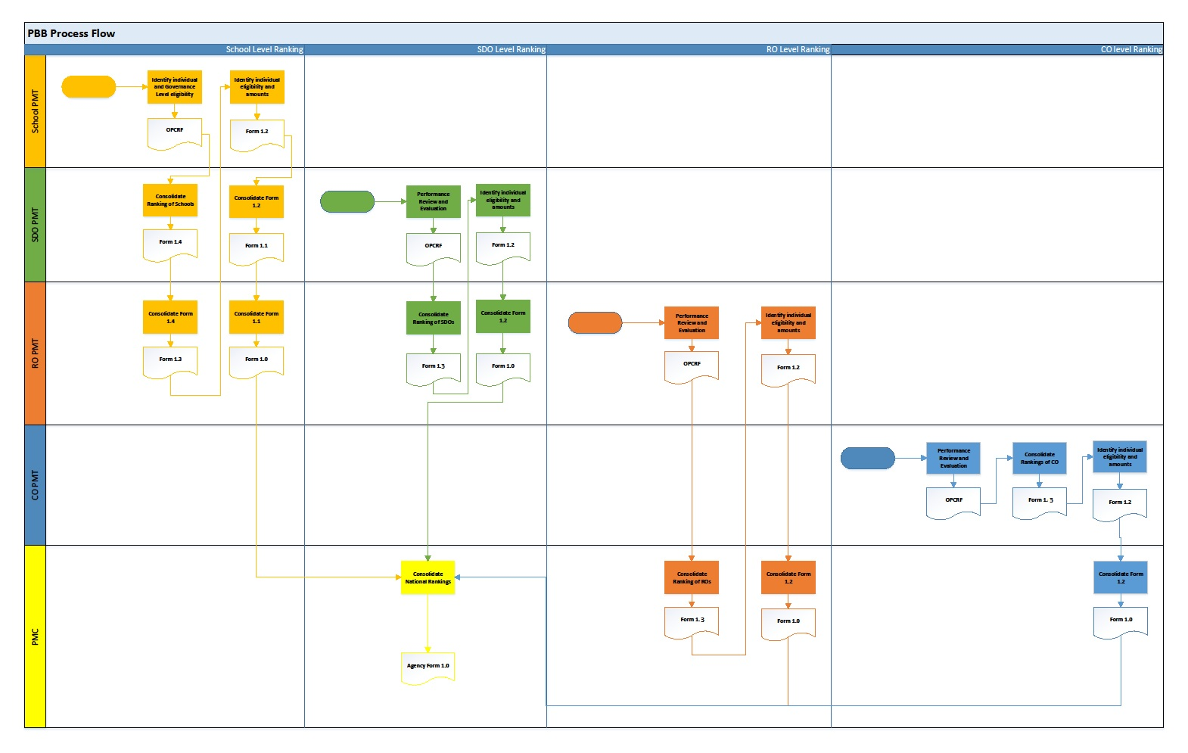
Process Flow

Slide 39
Communication Plan
PMC Secretariat to conduct PBB Orientations to RO and SDO PMT Representatives
RO and SDO PMTs to cascade orientations up to the school level
RO PMTs to submit all regional and division memoranda constituting the RO, SDO, and School PMTs.
Submit name and contact details (landline, cellphone, email address) of the assigned focal person
Open communication channels
Official Mailing Address: PMC Secretariat c/o Personnel Division, DepEd Complex, Meralco Ave., Pasic City 1600
Email account: pbb.secretariat@gmail.com
Landline numbers: (02) 636-6546 / 633-9345

Slide 40
Appeals Process

Slide 41
Performance Management Committee
1
Letter Addressed to Chair
2
Regional Office Performance Management Team (RO PMT)
Resolution w/in 15 days
Ranking Appeals
1
Schools Division Office Performance Management Team (SDO PMT)
CC: SDO PMT
School Performance Management Team
(School PMT)
3
Appeal Addressed to Chair
FINAL Resolution w/in 15 days
4
School Appeal

Slide 42
Performance Management Committee
1
Letter Addressed to Chair
2
Regional Office Performance Management Team (RO PMT)
Resolution w/in 15 days
Ranking Appeals
Schools Division Office Performance Management Team (SDO PMT)
FINAL Resolution w/in 15 days
Appeal Addressed to Chair
3
4
SDO Appeal

Slide 43
Performance Management Committee
2
FINAL Resolution w/in 15 days
Ranking Appeals
Regional Office Performance Management Team (RO PMT)
Appeal Addressed to Chair
1
Regional Office Appeal

Slide 44
Performance Management Committee
1
Letter Addressed to Chair
2
Central Office Performance Management Team (CO PMT)
Resolution w/in 15 days
Ranking Appeals
Central Office Bureau or Service
FINAL Resolution w/in 15 days
Appeal Addressed to Chair
3
4
CO Bureau or Service Appeal

Slide 45
Performance Management Committee
2
FINAL Resolution w/in 15 days
Ranking Appeals
School Performance Management Team (School PMT)
Appeal Addressed to Chair
1
Science High School Appeal

Slide 46
FINAL
Performance Management Committee
Resolution w/in 15 days
Appeal to Chair w/in 15 days
Individual Appeals
RO PMT
Resolution w/in 15 days
Appeal to Chair w/in 15 days
SDO PMT
Resolution w/in 15 days
Appeal to Chair w/in 15 days
School PMT
Resolution w/in 15 days
School-based Personnel
Letter addressed to Chair

Slide 47
FINAL
Performance Management Committee
Resolution w/in 15 days
Individual Appeals
Appeal to Chair w/in 15 days
RO PMT
Resolution w/in 15 days
Appeal to Chair w/in 15 days
SDO PMT
Resolution w/in 15 days
SDO-based Personnel
Letter Addressed to Chair
Resolution w/in 15 days
Letter addressed to Chair

Slide 48
FINAL
Performance Management Committee
Individual Appeals
Resolution w/in 15 days
Appeal to Chair w/in 15 days
RO PMT
Resolution w/in 15 days
RO-based Personnel
Letter Addressed to Chair

Slide 49
FINAL
Performance Management Committee
Individual Appeals
Resolution w/in 15 days
Appeal to Chair w/in 15 days
CO PMT
Resolution w/in 15 days
CO-based Personnel
Letter Addressed to Chair

Slide 50
Good Governance Conditions
Transparency Seal
Annual Procurement Plan
QMS
System of Ranking Delivery Units
PhilGEPS Posting
Citizens Charter
X
SDO SDO PMT
RO RO PMT
CO CO PMT
National PMC
Isolation of Accountable Officers
Deficiency leading to Non-compliance
Performance Management Committee
Submit names of Highest Accountable Officer and all Staff in Charge
Determine Highest Accountable Officer (Unit/Division Head) and all Staff in Charge.
Isolated (Not included in PBB)

Slide 51
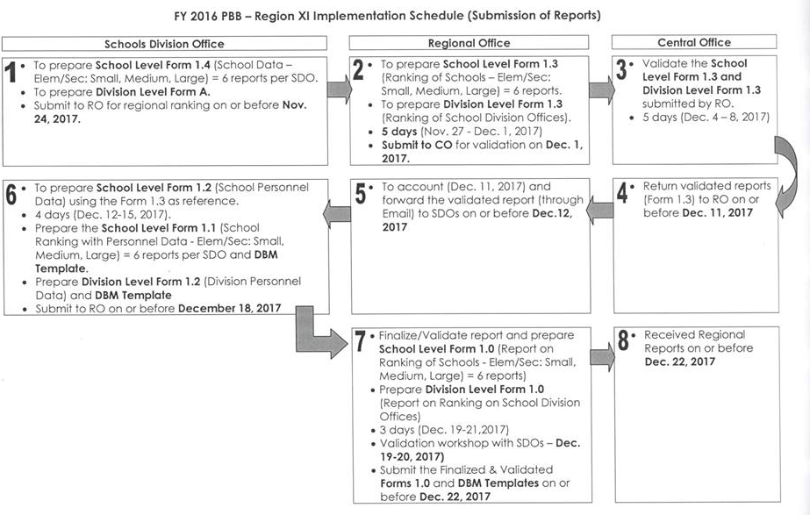
PBB Timeline

Slide 52
Thank you!

